Slide 1
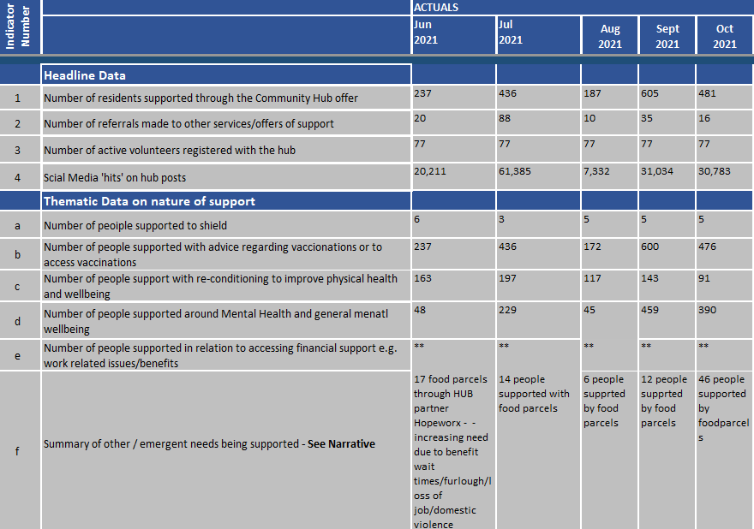

COMF = Contain outbreak management fund 2021-22 £100,000
The COMF monies is enabling the hub to continue to provide the locally focussed support to vulnerable residents, as it has done throughout the pandemic.
Supporting the wider system, enabling residents to self-isolate as required and to access the support and advice they require to remain safe.

Slide 2
Rochford Community Hub
Spend Plan 2021-22
Organisation | Activity
Hub@Megacentre | Cost of running TheHub@TheMegacentre including telephone costs, room hire, utilities, staff, publicity (flyers/logo/adverts) ongoing cost for developing partnerships
Citizens Advice | Room hires for CA to be present in the hub 2 days a week.
Hub@Megacentre & Partners | Celebration event/Open day/Market place for partners (including staffing, refreshments, resources, room hire, utilities, marketing)
Megacentre | Budget to provide for rent free hire of TheHub for partners
RRAVS | Financial support to continue to provide volunteers to support the hub and to ensure that the hub work is shared across the voluntary sector organisations
Hopeworx | To provide continued support with fresh foods for residents through the foodbank and community fridge based at the hub@theMegacentre
Church Networks | £10000 (grants up to £1000 or partnership bids up to £2000) funding available to church networks and organisations to create or support existing projects that meet the deliverables of the COMF monies to be administrated through the hub
Parish Councils | £6000 (Grants up to £500) funding available to church networks and organisations to create or support existing projects that meet the deliverables of the COMF monies to be administrated through the hub
RDC | Administration Costs for delivery of funding, promotion of hub and ongoing support

Slide 3
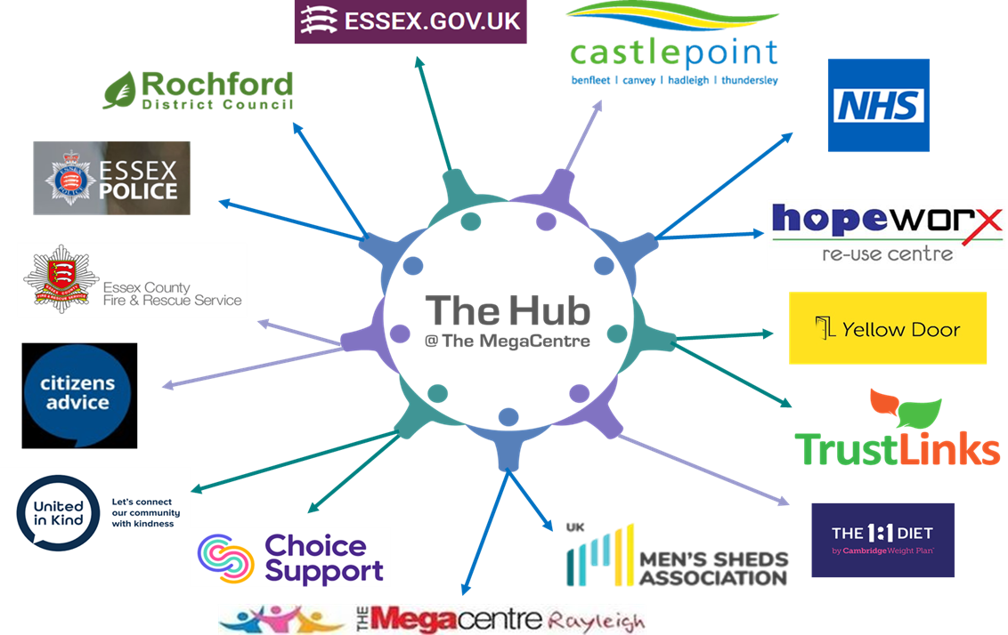
‘A community that can get help and more importantly help each other’
The hub brings together public sector, private/voluntary organisations and community groups to more effectively serve our community by sharing spaces, ideas, services, information and connecting each other in a way that has never been done before in the area.
The hub partnership has the simple desire to make things better for our community, by being a “one stop shop” for residents to contact, when they need support, such as:
Information
Support
Advice
Social Activities

Slide 4

Partners working the hub space
As a hub we are continuing conversations with local organisations and partners. Anyone that wants more information should contact: hub@megacentrerayleigh.co.uk
Partners soon to use the hub space include:
Pulmonary Rehabilitation Team - sessions will include physical activities and education and potential to join up with community sports sessions already well established at The Megacentre
Mother and baby checks
Coombewood community MH services
CCG Wellbeing Link Co-ordinators, Families in Focus, South Essex Child and Family Wellbeing Service
Citizen’s Advice – helpline offer from The Hub
Men’s Shed – a space where men can enjoy practical hobbies, making friends, learning and sharing skills, have a cup of tea and a chat
Choice Support – drop in crisis café, and 1:1 support for people with learning disabilities, autism and mental health needs
Hopeworx - Emergency food parcels and surplus food
United in Kind Castle Point & Rochford – Essex movement to tackle social isolation and loneliness in the county.
Megacentre Communities team – family and youth work including for children with SEND, support for parents, mentoring and counselling for young people
Megacentre Community Sports – open to everyone, an opportunity to play badminton, table tennis, short mat bowls and socialise, four days per week
TrustLinks - A Southend based mental health charity with the aim of supporting and inspiring people, use our hub as another base for their work
Essex Police – coffee with a cops – providing reassurance and crime prevention advice. The community can meet their local constabulary, ask them questions and tell them about problems in their area.
EPIC - a voluntary group run by adopters for children and families of adopted children that are of school age (5-18). Providing support and advice.

Slide 5
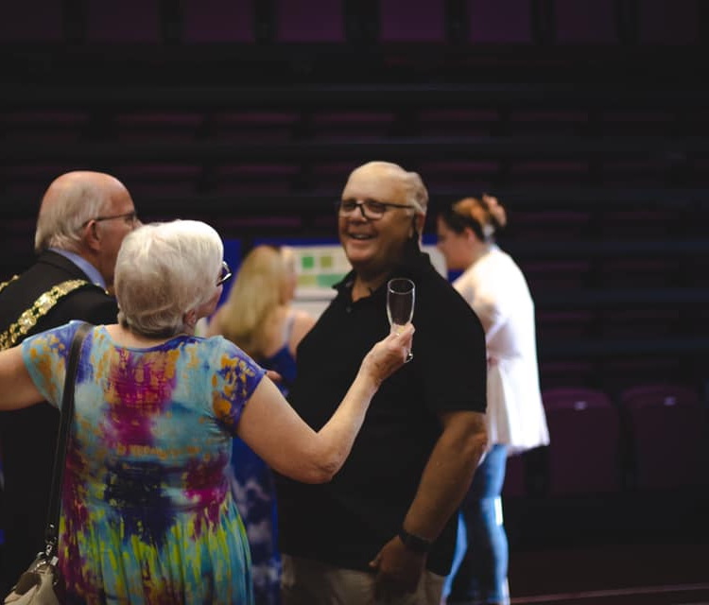
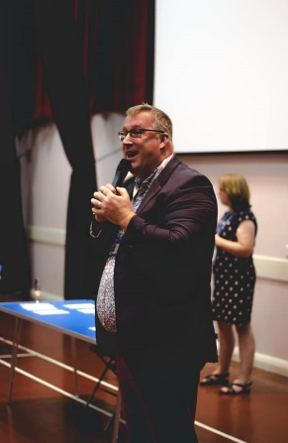
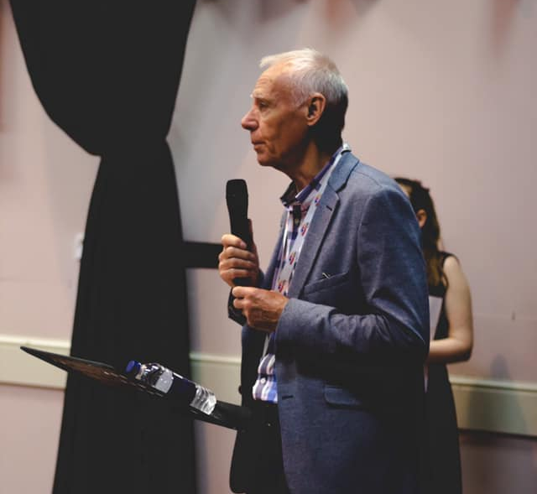
TheHub@TheMegacentre Launch and Engagement event 7th September 2021
With over 305 attendees on the day including residents, community volunteers, partner agencies and local Councillors it was a real opportunity to share and celebrate the story of the community hub. People were able to take a tour of the hub, see some of the activities live in action and meet key partners of the hub.
The event was an opportunity to hear about the hubs aspirations and plans for the future including:
Increased partnership working
Expanding the hub across the district, taking the hub out in to the community
Offer more services to reach other sections of the community
Cement the relationships with the partners and the community

Slide 6
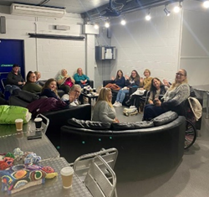
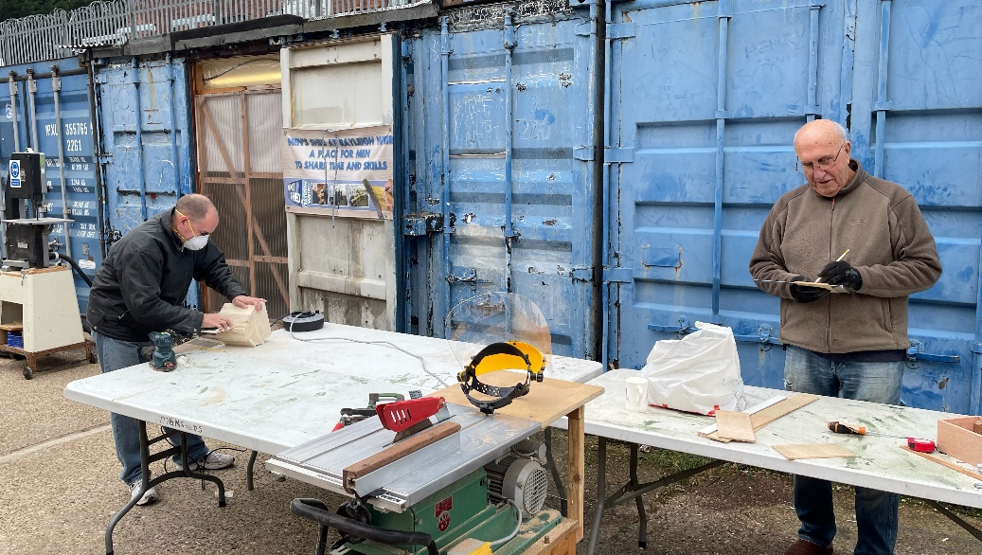
What has TheHub@TheMegacentre achieved in the first 6 months?
Number of residents reached through TheHub@TheMegacentre social media posts 150,745
Number of people supported with advice regarding vaccinations or to access vaccinations 921
Number of people support with re-conditioning to improve physical health and wellbeing 711
Number of people supported around Mental Health and general mental wellbeing 1171
Other needs identified include the need for food parcels – becoming more prevalent as furlough ends and the end of the Universal Credit uplift 206
What do people say about TheHub@TheMegacentre?
“Thank you for all your hard work. It does seem that our community has a high quality model of community support which, hopefully, set a vision for how the community and Megacentre can work for an exciting ‘new future’. Bless you.”
“Thank you. It feels strange having to ask for help, I am usually the person who helps”
“thank you so so much, this has really helped me in my time of need. I never thought I would be in this situation and I hate asking for help, but you have been so kind and understanding”
The Hug in a Shrug project
“Such a lovely group of ladies who meet every week who are members of the hug in a shrug group, they are pretty amazing, friendships have been made problems have been shared and a shoulder to cry on every now and then oh and a coffee and cake and lots of laughs too!”
“Sometimes just a friendly voice can mean so much to someone, it costs nothing to care.”
Men’s Shed
“you have, quite simply, saved my dad” – daughter of one of the Men’s Shed members.

Slide 7
What does having these partners working together mean for residents?
Residents have one telephone number to call – 01268 779999
Residents have one email address to contact – hub@megacentrerayleigh.co.uk
To access support, advice, information, social activities, friendship, help.
‘A community that can get help and more importantly help each other’

